Slide 1
Functional Behavioral Assessment
By Madeline Gelmetti

Slide 2
Don
Don is 10 years old and in third grade at Russell Elementary School
Don has attended Russell Elementary School in Rumney, New Hampshire since Kindergarten with a brief change in schooling to Bristol Elementary School for half of the year in second grade.
The summer after first grade, Don’s parents divorced and moved.
His father stayed in Rumney, and his mother moved to Bristol. After living with his mother for a few months, it was decided that she no longer wanted custody of Don. He does have a sister who stills remains in custody and lives with their mother.
Halfway through second grade, Don moved in with his father, his new wife and her three kids.
Previous to the divorce and moves, teachers said Don was a very “quiet and shy student”. Since he returned at the end of second grade, he has had three bus referrals, and has inappropriate behaviors in class.
His step mother informed us at a parent-teacher conference that she did find a knife in his backpack that he brought to school.
Has had issues with pretending to “hurt himself” and jokingly “cut himself” with knives at breakfast. He is no longer allowed use knives during breakfast or lunch and must ask an adult to cut his food for him.
Don does have a learning disability and is on an IEP for reading and math, although both scores have gone up this year.
While his academics are improving, his behaviors continue to be unsatisfactory.
His behaviors include disrupting others, refusing to follow directions, and throwing tantrums when frustrated.
If Don get’s upset, he “shuts down”.
When Don is in a good mood or happy, he is an absolute pleasure. His sense of humor is contagious.

Slide 3
Classroom Description & School Information
Russell Elementary School is located in Rumney, New Hampshire west of Plymouth.
The third grade classroom is at the end of the wing which connects the middle school to the rest of the school. On the opposite side of the wing is the fourth grade classroom, with a boys and girls bathroom across the hall. The nurses office is located next door to the third grade room, and teachers room is across the hall. Next to the teachers room is the speech room. It is quite a busy hallway.
The wing is located partially underground; the windows to the outside are high up on the wall so they start where the ground does. The view shows the playground and tables where students can sit when they’re outside. These windows let in a good amount of natural light.
The classroom has fluorescent lights, which thankfully do not make any buzzing noises.
In the winter, the heater cranks in hot air. The classroom is known for being quite warm, and something “too warm”.
There are 2 doors to the room since it is wide; only one is a functioning door. The other is blocked by Mrs. W’s door.
Mrs. W is the teacher for the third grade, she has a full time aide in the room named Ms. B.
Throughout the day, Mrs. M, the special education teacher and myself work in the classroom for extra support as well.
There are 16 students in the class, 5 of which are on IEP’s. These 16 students make up the entire third grade.
There are no rules posted.
The daily schedule is as follows
8:00 – 8:30: Morning meeting and “wake up” game
8:30 - 9:30: Math
9:30 – 10:30: Special
10:30 – 10: 45 Snack time
10:45 – 11:45 Word Study/Language Arts
-11:45 – 12:15 Recess
12:15 – 12:45 Lunch
1:00 – 1:30 Silent reading
1:30 – 2:30 Extra math period/science/social studies depending on the day
The room is a very big rectangular space; there is an entire shelf full of books and another full of games for indoor recess. In the back corner there are 2 working computers which students are allowed to use for research, free time and educational games. Students desks change often.

Slide 6
Observation 1 (part 1)
Interval 30 Seconds | Off Task | Fidgeting | Vocalization | Plays with Objects | Negative Behaviors
1a | x |  | x
1b | x |  | x
2a | x | x |  | x
2b | x | x |  | x
3a | x | x |  | x
3b |  | x |  | x
4a |  |  |  |  | x
4b
5a
5b
6a |  |  |  | x
6b
7a |  |  |  | x
7b |  |  |  | x

Slide 7
Observation1 (Part 2)
Interval 30 Seconds | Off Task | Fidgeting | Vocalization | Plays with Objects | Negative Behaviors
8a
8b
9a
9b
10a
10b | X |  |  |  | x
11a | X |  |  |  | x
11b | X |  |  |  | x
12a | X |  |  |  | x
12b | X |  |  |  | x
13a | X |  |  |  | x
13b | X |  |  |  | x
14a
14b
15a
15b

Slide 8
Summary of Observation 1
 | Off task | Fidgeting | Vocalization | Plays w/ Objects | Negative Behaviors
# of times | 13 | 7 | 2 | 7 | 9
# of trials | 30 | 30 | 30 | 30 | 30
Percentage | 43% | 23% | 7% | 23% | 30%
This first observation took place during the first 15 minutes of math. Don was busy playing with his pencil, and missed the directions to take out his math book and turn to page 97. 3 minutes in, he realized that he wasn’t doing what the rest of the class was and took out his book. He continued to fidget with his pencil, until the teacher asked the students to work on a problem out of the book on their own. Don asked if I could help him, and I told him I’d like to see if he could do it on his own. Don stomped away and put his face down in his book for about 3 minutes. He finally gathered himself and started working on the math. This accounted for 30% of negative behaviors occurring, and the 43% off task.

Slide 9
Observation 2 (part 1)
Interval 30 Seconds | Off Task | Fidgeting | Vocalization | Plays with Objects | Negative Behaviors
1a
1b
2a
2b
3a
3b
4a
4b |  | x
5a |  | x
5b
6a
6b
7a
7b

Slide 10
Observation 2 (Part 2)
Interval 30 Seconds | Off Task | Fidgeting | Vocalization | Plays with Objects | Negative Behaviors
8a
8b
9a
9b
10a |  | X
10b |  | X
11a
11b
12a
12b
13a |  | X
13b
14a
14b
15a
15b

Slide 11
Summary of Observation 2
 | Off task | Fidgeting | Vocalization | Plays w/ Objects | Negative Behaviors
# of times | 0 | 5 | 0 | 0 | 0
# of trials | 30 | 30 | 30 | 30 | 30
Percentage | 0% | 17% | 0% | 0% | 0%
This second observation took place during reading time. I came in to observe after silent reading had already began. Don was laying on the floor in the corner where the library book shelf meets the wall with windows. He seemed very engaged in his book throughout the whole observation period. Even after I stopped to walk around and check on what the student’s were reading, he still was engaged all the way until the end of the period. 17% of the time Don was reading, he was fidgeting with the previous pages. Although this is not a distracting behavior, I still decided to record it.

Slide 12
Observation 3 (part 1)
Interval 30 Seconds | Off Task | Fidgeting | Vocalization | Plays with Objects | Negative Behaviors
1a
1b
2a
2b
3a
3b | X
4a | X
4b
5a
5b
6a
6b
7a
7b

Slide 13
Observation 3 (Part 2)
Interval 30 Seconds | Off Task | Fidgeting | Vocalization | Plays with Objects | Negative Behaviors
8a |  |  | X |  | X
8b |  |  | X |  | X
9a |  |  |  |  | X
9b |  |  |  |  | X
10a |  |  |  |  | X
10b |  |  |  |  | X
11a |  |  |  |  | X
11b |  |  |  |  | X
12a |  |  |  |  | X
12b |  |  |  |  | X
13a |  |  |  |  | X
13b |  |  |  |  | X
14a |  |  |  |  | X
14b |  |  |  |  | X
15a |  |  |  |  | X
15b

Slide 14
Summary of Observation 3
 | Off task | Fidgeting | Vocalization | Plays w/ Objects | Negative Behaviors
# of times | 2 | 0 | 2 | 0 | 15
# of trials | 30 | 30 | 30 | 30 | 30
Percentage | 7% | 0% | 7% | 0% | 50%
This third observation took place in the morning. I wanted to see how Don did behavior-wise when he first gets to school. Putting away his coat and backpack went well. Unlike some of his classmates, he did what he was supposed to and then sat at his desk until they were reading to play their “morning warm up game”. That day they played a game called “Four Corners”. Don was in the first round of people to get out. He instantly became furious and blamed him getting out due to a classmate making a noise. Ms. W asked him to sit quietly at his desk to read while the rest of the class finished. Don stormed to his seat and muttered a few sentences under his breath. He continued to pout and refused to read until the game was finally over.

Slide 15
ABC Model Observation #4 This observation was done during the morning math period from 8:35-9:50. The students were doing independent work at their desks and then getting it corrected once they were done.
A Triggers (before behavior) | B Behavior “What” (specific behavior) | C Consequences (after behavior)
1.) Ms. B noticed Don had incorrectly answered a math problem he had done. She asked him to re-do the math since the answer was not correct. 2.) Ms. B returned and offered to help Don on his problems. She goes over one of them with him, and then asks him to try one on his own. Ms. B walks over to help another student, leaving Don. | 1.) Don became instantly frustrated and angry. He made a fist and banged once on his desk, while making an unhappy face. 2.) Don pouts for her not to go. He asks for further help and claims he doesn’t know what he is doing. When she does not respond or acknowledge him, he just sat at his desk not doing his work. | 1.) Ms. W put Don’s name on the board due to his inappropriate behavior. He was then left alone to “cool down”. 2.) Don was ignored and therefore just sat at his desk doing nothing.

Slide 16
ABC Model Observation #5 This observation was also done during math, which is when his disruptive and angry behaviors occur. I came in to observe towards the end of math, about 15 minutes before the class had to go to technology. They were working on independent math in their books.
A Triggers (before behavior) | B Behavior “What” (specific behavior) | C Consequences (after behavior)
1.) Ms. B was looking over students work. She stopped to check on Don, who had correctly completed the page so far. She continued to walk around and check other students. 2.) Ms. W asked the class to finish up the page they were on and quietly line up to go to technology. | 1.) Don stopped doing his work once he knew that the problems he had already done were correct. Don started to play with his pencil and spend 2 minutes doing nothing, then raised his hand for help. 2.) Don continued to do work as his classmates put away their work and got in line. He began rushing through his problems and would not stop or get into line. Ms. B stood by his desk and asked him to put his work away. He kept telling her to “hold on!” and still did not budge. | 1.) He regained the attention of Ms. B, who asked him to try on his own since he was already on a roll and doing so well. 2.) Ms. W gave him a 3 second countdown. When she reached “3”, he still hadn’t stopped so his name was written on the board. He finally reached a “good stopping point” and joined his class in line.

Slide 17
ABC Model Observation #6 My last ABC observation was done in the middle of morning math. This is where I work with Don daily, and where the majority of his behaviors occur. Today they were working on multiplication which is a new unit they just started. Don struggles greatly with multiplication.
A Triggers (before behavior) | B Behavior “What” (specific behavior) | C Consequences (after behavior)
1.) Don was struggling on a multiplication problem. Ms. B tried to explain a multiplication trick to make it easier to figure out. | 1.) Throughout Ms. B explaining to Don how to do the multiplication trick, he would cut her off with random number guesses of the answer. When she had him try the trick, he became frustrated and flipped the paper over. He angrily mumbled to himself and refused to let Ms. B continue to help him. He spent a few minutes with his head down on his desk without doing work. | 1.) Dons name was written on the board. The consequence was that he didn’t have to do his school work.

Slide 18
After comparing all of my observations, I totaled up the percent of negative behaviors causing time off task, time off task without negative behaviors, negative behaviors while still being on task, and fidgeting. Overall, negative behaviors seem to be the biggest problem with Don. He is constantly getting frustrated and angry. This disrupts the class and hinders his ability to learn. When Don gets angry, he usually will give up on his work. There aren’t any consequences in the classroom that currently help deal with Don’s frustration. Ms. B also complained that he was constantly fidgeting; as long as it is not a distraction to him or others, I believe fidgeting is an okay thing for Don to do and don’t think it is the behavior that needs targeting.

Slide 19
Teacher Interview (Part 1)
1.) What are the student’s strengths, skills, and interests?
Don has strong spelling skills. His reading skills are improving. He is very interested in science and animals.
2.) What are the student’s challenges and areas of greatest difficulty?
Don has difficulty in math. He has problems dealing with his anger when he gets frustrated.
3.) What people, things, and activities does the student like most?
Don likes to learn new things in science. He enjoys building structures with magnets and building blocks.
4.) What people, things and activities does the student like least?
Don does not enjoy doing any school work that he finds difficult. He will sit at his desk and not attempt to do any work without an adult sitting right next to him.
5.) What are the student’s problem behaviors?
His behaviors stem around refusal and anger.
How would you describe these behaviors?
Sometimes he will physically hit his desk with his fists when he is angry. Other times he will mumble under his breath.
Which are the most problematic for you? The physical outburst are the most difficult because it takes a long time for him to calm down.
How often do these behaviors occur?
These behaviors occur 3-5 times a week.

Slide 20
Teacher Interview (Part 2)
6.) What do you think causes (motivates) the behavior (i.e., why does the student do it)?
I think Don does these behaviors because he feels like he isn’t “wrong” in whatever throws him off.
7.) Under what circumstances do these behaviors occur most frequently?
These behaviors typically happen the most during instructional time, or independent time to complete an assignment.
In what settings (where)?
The classroom
What times of the day (when)?
Academic times
8.) Can you tell when the student is going to behave this way? How can you tell?
Don’s facial expressions turn very angry when he is going to act out.
9.) Do you think there are medical reasons for these behaviors?
No
Is the student sick, tired, or hungry?
No
10.) Are there situations in which the behaviors never or rarely occur? What are those situations?
I rarely ever see these behaviors during reading. Don enjoys reading.

Slide 21
Teacher Interview (Part 3)
11.) Does the student have better and more appropriate ways to deal with difficult situations and communicate wants and needs?
Don has been told that he can take a break away from his desk or go for a walk to get a drink if he is feeling frustrated.
12.) What skills does the student lack that might help his or her behavior?
Don lacks anger counseling which is something he needs.
13.) How do you react or respond to the student’s:
problem behavior?
Process behaviors
positive behavior?
Positive reinforcement such as high fives, stickers, free computer time
14.) Does the student’s behavior allow her or him to avoid things? If so, what?
His behaviors allow him to avoid work.
15.) What do you think needs to be done to help this student?
I think Don needs anger counseling. I also think he needs more intensive small group math instruction.

Slide 22
Classroom Aide Interview (part 1)
1.) What are the student’s strengths, skills, and interests?
Reading, spelling, writing, very organized and loves to help and have a job to do. He likes to play cards, talk about what he does outside of school and be busy with his hands.
2.) What are the student’s challenges and areas of greatest difficulty?
Transitions can be difficult for him because if he is not finished with what he is working on, he like to finish and that can be difficult when he needs to move on. When I correct him in math he can get very upset if he is wrong.
3.) What people, things, and activities does the student like most?
Adults, one on one with a student, cards, cars, animals, gym, reading, writing and art.
4.) What people, things and activities does the student like least?
no comment
5.) What are the student’s problem behaviors?
Talking back to teachers and using his hands when he shouldn’t be. (tapping desk or water bottle loudly during lesson)
How would you describe these behaviors?
Disrespectful and disruptive.
Which are the most problematic for you? When I have to take something away from his desk area because he is doing something other than what he should be doing.
How often do these behaviors occur?
It depends on the day. Sometimes twice a day.

Slide 23
Classroom Aide Interview (Part 2)
6.) What do you think causes (motivates) the behavior (i.e., why does the student do it)?
He likes to do things with his hands, he likes to be right with his work and takes pride in his hard work, so he doesn’t like to be corrected. I’m not sure why he talks back, I don’t think he likes to be called out on doing something wrong. He works hard on his work and likes to finish it before moving on.
7.) Under what circumstances do these behaviors occur most frequently?
With whom (who)?
Students, myself and the classroom teacher
In what settings (where)?
Classroom, lunch and specials
What times of the day (when)?
Throughout the day, math writing, reading, group, specials, science and social studies
8.) Can you tell when the student is going to behave this way? How can you tell?
Yes, transitions. If he doesn’t have his work finished, I know he is going to keep working on it. If he needs a correction, he will get upset.
9.) Do you think there are medical reasons for these behaviors? Is the student sick, tired, or hungry?
No medical reasons. Maybe tired sometimes.
10.) Are there situations in which the behaviors never or rarely occur? What are those situations?
It will usually occur throughout the day but not all the time.

Slide 24
Classroom Aide Interview (Part 3)
11.) Does the student have better and more appropriate ways to deal with difficult situations and communicate wants and needs?
If he can stay calm and is spoken to nicely he will usually be okay but I don’t think he can help himself with talking back and wanting to finish his work. He can be quiet when talking to you but he will communicate with you when he needs to explain himself of needs help with something.
12.) What skills does the student lack that might help his or her behavior?
Self control and joining the group when he needs to. He arrives when it works best for him.
13.) How do you react or respond to the student’s problem behavior? Positive behavior?
I give him a warning and then I take away what he is playing with. I write his name on the board and take away recess minutes. I ignore when he gets upset when I correct his work and when he talks back. Sometimes I tell him its not okay to be disrespectful to adults. I reward him with stickers and positive encouragement.
14.) Does the student’s behavior allow her or him to avoid things? If so, what?
He gets stickers when I see positivity and hard work from him.
15.) What do you think needs to be done to help this student?
Encouragement when he is doing well, and something to keep his hands busy. A job for him to do so he feels important too. Something to help build his peer relationships, and consequences for talking back.

Slide 25
Functional Behavior Assessment Part 1
Description of Behavior: Behavior 1: Don has angry out bursts in which he will slam his fist into the desk, refuse to do work, and mutter under his break. Behavior 2: Don does not follow directions if he feels they do not benefit him or he is not ready to transition.
Setting(s) in which behavior occurs: Both of the behaviors occur mainly within the classroom. Don becomes the most frustrated and angry during math.
Frequency: According to Ms. W, Don becomes angry and has an outburst, will refuse work or bang his fists about 3 to 5 times a week. He has trouble following directions and transitioning almost daily.
Intensity (Consequences of problem behavior on student, peers, instructional environment): When Don becomes angry, he can act out semi-violently or in a manner that attracts attention to him. His peers who sit nearby can be distracted by his out bursts. When he does not follow directions during transitions, it effects the class as a whole. Don’s classmates have longer, more drawn out transitions due to his lack of cooperation. They have been late for recess, lunch and specials due to “Don not being ready to transition”.
Duration: When Don becomes angry, he can be in a funk for a while after that. His actual angry outbursts usually last a few seconds to less than a minute. The time in which Don wastes transitioning can be anywhere from a few seconds to a few minutes.
Describe Previous Interventions: Both his teacher and the classroom aide handle these behaviors by taking away recess, putting his name on the board, verbal discipline and warnings, and ignoring these behaviors. None of these “interventions” work, nor should they. There have no been any official interventions or changes made to help shape Don’s behaviors.
Educational impact: The impact of his behavior is that he get’s out of doing school work. When he has a tantrum and refuses to do his work, he gets ignored so he can “calm down”. The ways in which he is disciplined also does not allow him to finish his work. His negative behaviors keep him from being taught and getting the practice that he needs.

Slide 26
Functional Behavior Assessment Part 2
Function of Behavior
Affective Regulation/Emotional Reactivity Although not diagnosed, Don shows signs of depression and poor self- concept. I believe these play a large factor in his increased behavioral issues that have risen in the past year. His anger is one of the key factors when it comes to the behavioral problems that Don struggles with.
Cognitive Distortion Don views himself as “not good enough” and will call himself “stupid”. When he struggles with something, he can put himself down. Since he doesn’t feel as though he is smart, being critiqued or having help offered makes him defensive. His frustration and anger comes from defending himself.
◻ Reinforcement Transitions are definitely a trigger for Don. Being corrected and not understand something are both major triggers for his anger and negative behaviors.
Modeling I do not feel as though his behavior is copied.
◻ Family Issues His family issues play a large part in his negative behaviors and anger problems. It wasn’t until his parents divorce that Don became difficult in school. All of his teachers said he was a very quiet and shy student. The divorce left Don and his little sister (who he talks about all the time and loves very much) in custody of his mother. After a few months, Don’s mother no longer wanted custody of him, and he moved in with his father, and away from his sister. This is when Don started showing negative behaviors, being off task and anger.
Physiological/Constitutional Don gets frustrated easily and is usually not able to handle being corrected in any way.
Communicate need Underneath it all, Don’s actions say that he is insecure and scared of rejection and criticism.
Curriculum/Instruction Math is Don’s worst subject; he struggles daily in mathematics. Most of his negative behaviors occur during this subject. If transitions were lead to be smoother and Don was given a heads-up that the period is almost over, his problem behavior at these points may be different.

Slide 27
Functional Behavior Assessment Part 2 (continued)
Hypothesis About Don’s Behavior
Don engages in off task behaviors such as refusing to cooperate during times of transition in order to accomplish what he feels necessary to boost his self esteem. When Don engages in negative behaviors such as angry outbursts, it is due to a much deeper problem within him stemming from recent rejection by his own mother. Don’s angry outbursts also are due to getting out of work that he does not understand or does not want to do. His negative behaviors occur mostly in math when he is frustrated or corrected on something.
Develop An Intervention Plan Based on Hypothesis
(See attached behavior plan!)

Slide 28
Theorist Dr. William Glasser The Control Theory/The Choice Theory
Choice theory has ten propositions which highlight the key aspects of Glasser’s beliefs. These themes revolve around the fact that the only person who can change a behavior is themselves; the only thing outside sources can do is provide the information and tools in order for others to help themselves. Choice theory also projects the idea that our past does have to do with who we are today and people are driven to satisfy the five basic needs which are survival, love and belonging, power, freedom and fun.
Don has the most trouble handling criticism, and can become easily frustrated. When either of these things occur, the emotions turn to anger which is something Don does not have control over. The biggest issue with him is his anger and how he handles it.
Interpreting Don from the standpoint of Dr. William Glasser, I think he would have the perfect explanation for his behaviors. As much as Don’s teachers discipline him, there isn’t anyone giving him the tools he needs in order to help himself. This is why his negative behavior continues to be a problem. Don does not realize the impact of his behavior, nor does he have the skills to cope with them.
The past may be a reason in which Don has accumulated anger issues. He never had them until his parents divorced. Through the messy divorce, it was decided that he reside in his mothers custody. Don’s mother had a very hard time handling him, and switched him to full time custody of his father. His little sister, who he is very close with, still lives with his mother because she is “more tolerable”. One of the reasons in which Don needs constant adult help and approval is because he has faced such harsh rejection at such a young age. He still longs for the feeling of love and belonging and will try to do whatever it takes in order to get attention. Criticism is hard for him to take because he see’s it as rejection. The anger he feels towards the situation still effects him in other parts of his life, such as school. There are many connections between Don’s behaviors, his past and the five basic needs.

Slide 29
FBA/BSP Student: Don Madeline Gelmetti
Feature 1 | Skill Set | Write In Response
Develop a Behavior Pathway and Summary Statement | Define problem behavior in observable and measurable terms. | Becoming angry, slamming fists and refusal of work when frustrated or given criticism/being corrected
 | 2. Describe problem behavior in terms of frequency or rate and intensity. | Although his behavior does not occur daily, during a 15 minute long observation, Don was off task for 43% of the time and showing negative behaviors including an angry out burst and refusal to do his work as told. These behaviors are reported to occur 3 to 5 times a week.
 | 3. Identify immediate triggering antecedent or, if possible, distant setting events. | The immediate triggering antecedents are when Don is corrected by a teacher, given criticism, or gets overly frustrated with work or a task.
 | 4. Determine if the problem behavior occurs in one or more routines. | Routine 1: During independent work in math Routine 2: During one on one instructions during math
 | 5. Identify possible function of behavior or maintaining consequence events for each problem routine. | Routine 1 & 2: Don is able to get out of doing the expected work. He also psychologically defends himself from rejection, being wrong and failing.
 | Develop complete summary statement which includes problem behavior, problem routine, triggering antecedents and function or maintaining consequences. | Don shows negative behaviors such as angry out bursts 3-5 times a week during independent math work and one-on-one math work when he is corrected by a teacher or becomes overly frustrated with a task in order to get out of the expected work and to psychologically defend himself from failing.

Slide 30
Feature 2 | Skill Set | Write In Response
Developing Replacement Behavior Based on Function | 1. Identify student strengths and interests to inform reinforcement and behavior plan strategies. | Don’s strengths are reading, spelling, writing, and being organized. Science and social studies are Don’s two favorite subjects. He enjoys building, playing with cards and do kinesthetic activities. Don loves to work with teachers one-on-one and does very well when given a job or responsibility.
 | 2. Identify short-term replacement behavior(s) for the problem behavior for each problem routine. | Routine 1 & 2: During working independently and small groups, if the student shows warning signs of becoming frustrated, have them take a quick sensory break or go for a quick walk. If the student has a problem incorrect, discreetly ask them to “retry” the problem via sticky note.
 | 3. The short-term replacement behavior(s) are matched to the apparent function of the problem behavior for each routine. | Routine 1 & 2: By allowing Don to take a break when he first starts showing signs of frustration, or he is working on a tough assignments, will let him deescalate. Sensory breaks also relax the mind and help destress. By discreetly letting Don know to “retry” a problem through a sticky note or predetermined hand motion, it eliminates the negative emotion that can come with being corrected. Don wont feel embarrassed in front of his peers, and may even feel special that he gets a sticky note or “secret hand motion”.

Slide 31
Feature 3 | Skill Set | Write In Response
Identify Strategies For Behavior Support Plan (BSP) | 1. Select strategies that minimize impact of setting events or make triggering antecedents irrelevant or ineffective. | Teach strategies to Don that help him deal with the feeling of being overwhelmed and any other problems he may be experiencing. Allow Don to have preferred responsibilities, especially ones around the math period. Provide Don with constant positive feedback when he is on task. Don’s consequences should also match the unwanted behavior.
 | 2. Select strategies that teach student skills that make problem behavior less efficient and effective including the replacement behaviors. | Through managing his own emotions and learning to handle negative feelings, Don will learn that his behaviors are not appropriate. Giving him responsibilities will make him feel important, as well as positive feedback when he is on task.
 | 3. Select strategies that make the maintaining consequences for problem behavior less effective – minimize the impact of inadvertently reinforcing the problem behavior. | When Don has an angry outburst, he is to make up the missed work that he would have been doing at another time. This make-up time should be done during specials, silent reading, or another period that Don wants to be a part of (just not recess!)
 | 4. Select punishment strategies that reduce the likelihood the problem behavior will reoccur. | Having Don do the work he misses due to refusal of any type or reason should be a punishment. This takes time out of other things he may want to be doing in order to finish his work. Each time he is about to have an angry outburst, he will be reminded that the work he is about to refuse to do will still have to be done, and at a time taken out of his schedule.
 | 5. Select reinforcement strategies that make replacement or desired behaviors more effective. | Giving positive reinforcement and showing that the teachers in the room notice how well he is handling himself can make a huge different. Allowing him to have responsibilities due to good behaviors can also make desired behaviors more effective. When he controls his anger, rewarding him with extra time doing something he likes can encourage the positive behavior.
 | 6. The reinforcement strategies include student’s strengths and interests or things the student finds reinforcing. | Social reinforcements and giving Don extra responsibilities such as line leader, being the student who retrieves snack from the café, or having a job within the classroom will help him thrive and become more confident.
 | If necessary, develop emergency procedures if behavior escalates. | If Don’s behavior were to ever escalate (which I don’t ever see happening), the first thing to do would be to evacuate the rest of the class. If he becomes violent, no other students should be at risk of getting hurt. At that point, a teacher should stay in the room to try and deescalate the student while the principle or an administrator can come to the room to assess the situation and go from there.

Slide 32
Feature 4 | Skill Set | Write In Response
Develop a Plan to Monitor Progress | 1. Develop observable and measurable outcomes with specific criteria for success. | Don will deescalate when becoming frustrated 3 out of 4 times by taking a sensory break or going for a quick walk. Don will calmly vocalize his feelings every single time he feels frustrated or angry. Don will complete all work that is missed due to negative behaviors within 2 school says of the incident.
 | 2. Develop specific criteria for success. | Teachers will constantly monitor Don and his work to look for signs of a negative behavior. If it is evident that he is getting angry or frustrated, they may give him a quick responsibility to fulfill in order to change his mindset and redirect him. Don will be given management strategies for his anger and frustration so he can learn to eternally handle situations.
 | 3. Identify how data will be collected to monitor progress and provide form or tool. | Data will be collected through brief incident reports used only for Don. Each time he has an angry outburst, it will be recorded when, why and what work was missed. It will also be recorded when Don calmly discusses his frustration or anger, shows signs of frustration/anger but deescalates, or is sent for a break by a teacher.
 | 4. Develop a schedule for assessing progress. | Assessing progress will be done formally by looking at the data from previous weeks. Data will be collected informally by things the teachers in Dons classroom have picked up. Each Friday morning, the teachers in the classroom and I will discuss what worked best that weekend, any negatives or positives and how Don is doing overall.

Slide 33
Feature 5 | Skill Set | Write In Response
Develop a Detailed Action Plan to Implement the BSP. | 1. Identify who will do what by when. | By February 10th, I will have gone over coping strategies and talked to Don about appropriate ways to handle his negative emotions. Ms. W will find responsibilities for Don to pick from once his behavior starts to improve. She will also make an official schedule exclusively for Don showing the time periods in which he will make up work if he misses it for any reason. This will all start the week of February 10th.
 | 2. Identify how the plan will be shared with other members of the team, staff and family. | Ms. W and Ms. B were aware of the FBA and the results have been shared with them. We had discussed the new strategies implemented and the means of discipline that they are using now that are not helping the negative behavior and making it worse in some cases. Don’s parents are already aware of the FBA. They will be informed of the finding and new strategies implemented at the next upcoming IEP meeting for Don.
 | Identify any training necessary to support fidelity of implementation. | None of the strategies need training, nor do any of the classroom teachers. Before meeting with Don, I will research and find the best anger-coping strategies for a child his age to discuss and practice with him.

Slide 34
Reflection
1.) What would you do differently next time?
If I were to do this FBA over again, I would want to have a psychological opinion on Don and his angry behaviors. It is not common for third grade students to have outbursts like Don does. I think it would be more helpful to find strategies to help reduce and replace the behavior as well as change the antecedent officially knowing the psychological aspect of anger disorders. Ms. W constantly brought up how she feels Don needs anger management, and not just an in-class intervention. I think it would help all educators and family members of Don’s family to get him tested psychologically. The results could help pinpoint what we need to focus on in order to improve his behaviors.
Another thing I would do differently regarding to this project is give myself more time to try different strategies. As of right now, this FBA has only been implemented two days due to snow days and an absence. At this moment, I don’t know what will and wont work for Don. Since I’m in the school for another few months, I will be carrying out these strategies then.
2.) How could you improve your intervention plan, based on your results?
The implementation of the strategies were done in a span of time too short in order to evaluate the results. Therefore, my current results are inconclusive. Before analyzing results of the FBA, I would want to have data showing the implementation of strategies and knowledge on his behaviors during math for at least 3 weeks prior. For me to make a judgment on what I would change based of off one week of results would not be relevant.
3.) What are the conclusions of designing and implementing this plan to your general teaching and behavior management skills?
Doing FBA’s helps evaluate students and their behaviors whether we are trying to or not. Ever since doing my first FBA in undergrad, I find myself observing behaviors, the triggers and thinking of strategies to decrease it. It is always done informally, but I find myself using pieces of FBA tools on a weekly basis. Writing formal FBA’s help dissect behavioral problems down to the core in order to find strategies that truly apply to that individual student.
4.) What are the implications of addressing language and communication skills when addressing student behavior?
N/A
5.) What are the key things you have learned about promoting responsible behavior in educational settings with students with behavioral disabilities through this assignment?
One of the most important thing that FBA’s have shown me is that you can try all of the interventions in the world, but without that positive relationship between the teacher and student, rarely will you be able to make a dent in their behavior. Students need to know that us educators are looking out for them and want to help their behaviors in order for them to be successful in life. We do FBA’s and try to dissolve negative behaviors because we care.

Slide 35
Appendix

Slide 48
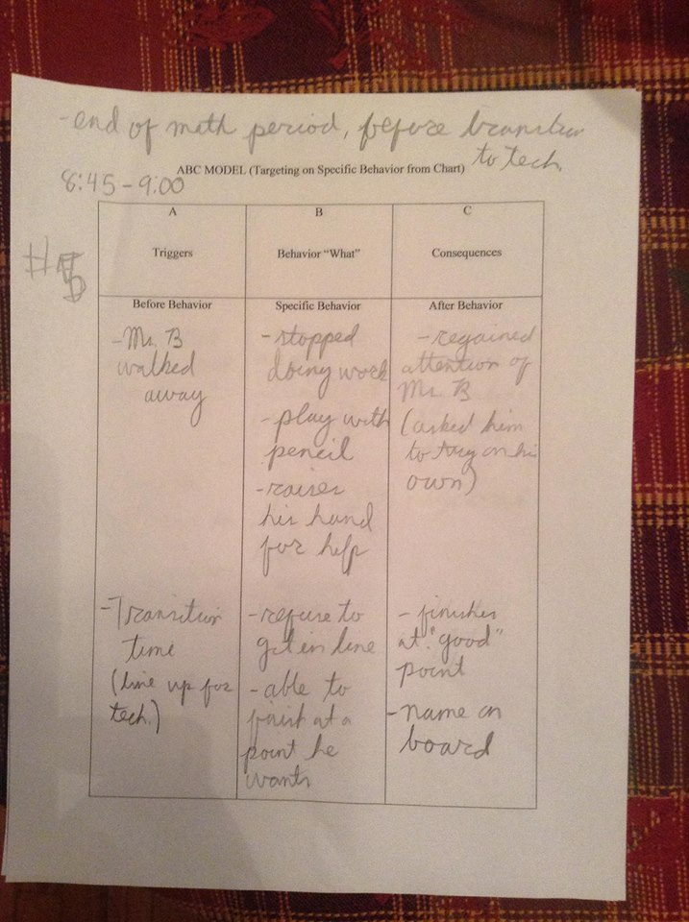

Slide 49
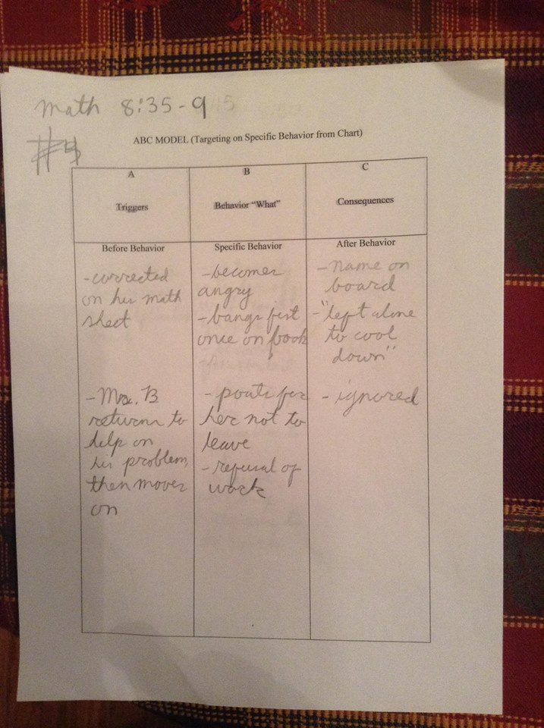

Slide 50
