Slide 1
Skill Theme Approach
By: Nick Ford
&
Matthew Dancosse

Slide 2
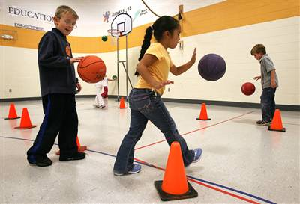
What is the Skill Theme Approach?
“The selection of a skill and all of the variables that accompany that skill for a student; the variables that accompany the skill (Concepts, Context, Combinations).” (Lund, 2005)
"Physical education and character education go hand in hand | Character Counts In Iowa." Character Counts In Iowa. N.p., n.d. Web. 27 Feb. 2012. <http://www.charactercountsiniowa.com/2011/11/08/physicaleducation/#.T0wFlNVt3ao>.
Notes:
In order to understand the Skill Theme Approach it is necessary to first understand motor development. This teaching style focuses on developing certain skills in a progression. The 4 bases of Skill Theme Approach are; body awareness, spatial awareness, effort, and relationships (Lund, 2005)

Slide 3
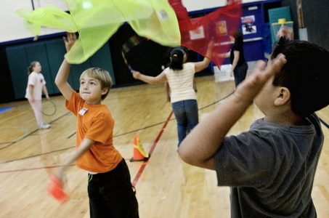
Characteristics
Focus is on the individual child as a whole in a variety of contexts (Lund, 2005)
Curriculum design that promotes:
Locomotor
Nonlocomotor
Manipulative
" Oregon students get scant PE classes, state documents | OregonLive.com." Oregon Local News, Breaking News, Sports & Weather - OregonLive.com. N.p., n.d. Web. 27 Feb. 2012. <http://www.oregonlive.com/news/index.ssf/2009/03/oregon_students_get_scant_pe_c.html
Notes:
Focuses on the individual child and not just the chronological age or grade level of students. “The skill theme approach is characterized by curriculum design that promotes competence in a variety of locomotor, nonlocomotor, and manipulative skills. It also provides developmentally appropriate experiences and instructional appropriate experiences that reflects the needs and interest of the students” (Lund, 2005)

Slide 4
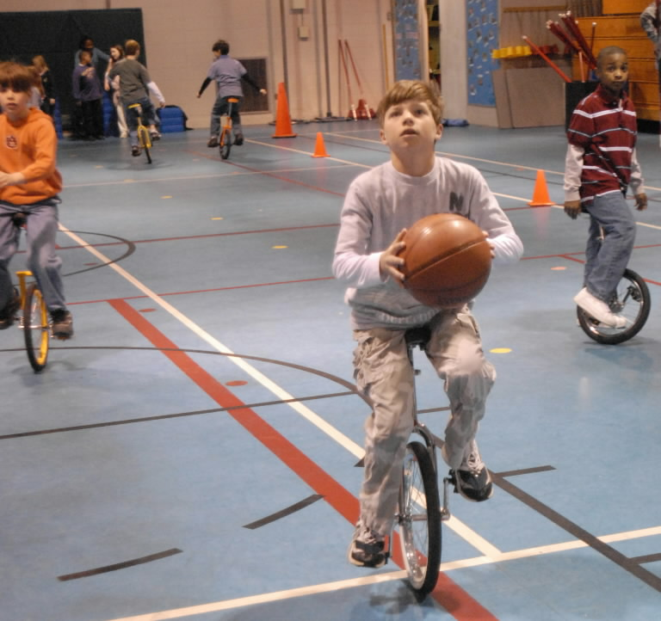
What makes it different?
Physical Education VS Recess
Developmental level VS grade/age level
Whole student/not sport specific
(Lund, 2005)
" Gwin Elementary School P.E. students learn unicycling, juggling, etc. | al.com." Alabama Blogs and Bloggers - al.com. N.p., n.d. Web. 27 Feb. 2012. <http://blog.al.com/hoover/2008/04/gwin_elementary_school_pe_stud.html
Notes:
In 1970 recess and PE were combined into one subject. The curriculum was not well defined and students did not learn skills for lifelong activities. In England Physical Education was separate from recess. The curriculum involved movement experiences that were appropriate for young children. Physical Education teachers went to England and learned about this teaching style and brought it back to the United States. It offered students the chance to learn skills not only for the game but for lifelong activities. Prior to the Skill Theme Approach students were taught by their age/grade level rather than their motor developmental level. This style allowed students to be taught based on their skill level. (Lund, 2005)

Slide 5
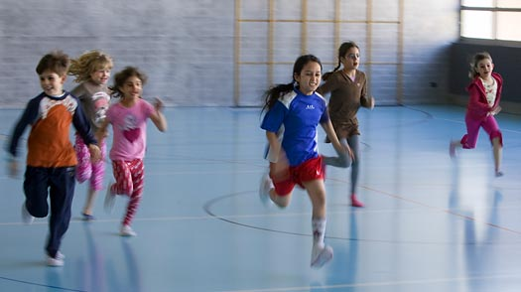
Student Benefits
Learn skills for lifelong activities
Become well rounded individuals in multiple skills.
Understanding of movement concepts:
Body awareness
Spatial awareness
Relationship
Effort
"Physical Education Classes More Than Just Gym | Dance Education." Dance Education. N.p., n.d. Web. 27 Feb. 2012. <http://www.laylahabib.com/72-physical-education-classes-more-than-just-gym.html>.
Notes:
Students in the past learned how to dance and do gymnastics. These skills did not give students the chance to become proficient in other things. By learning a variety of skills it allows students to become well rounded and have a better understanding of their body and how to control it (Lund, 2005).

Slide 6
Movement Concepts
Body Awareness | Spatial Awareness | Effort | Relationship
Whole body: Stretch curl, twist Parts of the body: alone, in combination, initiating/following, stretch/curl/ twist, meeting/parting Weight bearing: support, transference of weight, balance Actions: locomotion, elevation, turns Body shapes: round, narrow, wide, twisted Symmetrical/ Asymmetrical use of the body | General space 2. Personal space 3. Direction in space 4. Levels in space 5. Pathways in space: floor/Air 6. Extensions in space: far, near, large, small | 1. Time: sudden/ sustained 2. Weight: heavy/light 3. Space: direct/flexible 4. Flow: bound/ free | 1. With objects: manipulative Non-manipulative 2. With People
(Lund, 2005)
Notes:
Body awareness, Spatial awareness, Effort, Relationships

Slide 7
Value Orientation
Discipline Mastery
Focus is on skill acquisition
Skills are used in complex applications
Movement concepts and skills are developed
(Lund, 2005)
Notes:
The philosophy of the Skill Theme Approach is for students to be able to develop skills for lifelong activities. Students are given multiple objects/difficulty levels in which they can apply the skill to. Once students master a skill they are then able to apply the skills in a combination to become proficient in a group of skills. For example, students will learn to throw while being stationary and also while running. The skills will not be developed solely to learn how to play baseball but for a variety of things in life that someone might need to throw Lund, 2005)

Slide 8
Essential Elements
(Graham, 1980)
Notes:
The framework wheel depicts the interaction of movement concepts and skill themes. Throughout the wheel the major focus is the skill themes with a subtheme of movement concepts. “The circular interaction between the skill themes and movement concepts can be represented schematically by five concentric circles. The two inner circles represent the skill themes; the three outermost circles represent the movement concepts”. The two inner circles include the general categories of skill theme: manipulative, non-locomotor, and locomotor. The outermost circles include 3 categories of movement concepts: spatial awareness, effort, and relationships (Graham, 1980).

Slide 9
Activity Time!
Find a partner
Wait for more Instructions!

Slide 10
Alignment to NASPE Standards and NH State Guidelines
Standard 1: (NH Guideline 3)
Demonstrates competency in motor skills and movement patterns needed to perform a variety of physical activities
Standard 2: (NH guideline 4)
Demonstrates understanding of movement concepts, principles, strategies, and tactics as they apply to the learning and performance of physical activities
Standard 3: (NH Guideline 1)
Participates regularly in physical activity.
Standard 4: (NH Guideline 2)
Achieves and maintains a health-enhancing level of physical fitness.
Standard 5: (NH Guideline 6)
Exhibits responsible personal and social behavior that respects self and others in physical activity settings.
Standard 6: (NH Guideline 5)
Values physical activity for health, enjoyment, challenge, self-expression, and/or social interaction.
(National Association for Sport and Physical Education, N. D.)
Notes:
The standards are what the students should know and be able to do.
Standard 1: Students are to become competent in the skill , competency is develop through skill practice in a static state followed by a dynamic state, then an application of the skill in an ever changing environment.
Standard 2: Students are given the concepts of the skills in which they will later they are combined with skill application in which the students can develop an understanding of the skill.
Standards 3 & 4: Students are not made to perform traditional activities such as formal exercises or running laps. The skill theme approach does not aside time to focus on fitness. It is expected the fitness is incorporated throughout the activities and the skills that are being performed.
Standard 5: Standard 5 isn’t the major focus of the skill theme approach. The skill them approach incorporates standard 5 in it by planned activities as well as a safe and positive learning environment.
Standard 6: The goal of a skill theme physical education program is physically educated individuals. Students should be able to know the basic concepts and principles in which they can use not only in physical education but also with recreation.

Slide 11
Structure of Skill Theme Approach
Phase one – Development of the basic skill cognitively and performance understanding (Lund, 200)
Mastery of skill at developmental level
Example: Dribbling in space without defender/direction
Notes:
Students will learn the skills according to their developmental level. Students will also learn the cues and essential elements to the skills in accordance with the developmental level. Students will perform the skill in an open environment with no distractions or obstacles.

Slide 12
Structure of Skill Theme Approach
Phase two – skill is taught with movement concepts and/or other skills are added (Lund, 200)
Body positions, Levels, Directions, and pathways are added
Example: Dribbling around cones, lower, higher, each hand
Notes:
Skills are slowly becoming more complex. Rather than applying the skill to a game setting the skills are taught with different goals. These goals can be set up using small drills that force students to use different movement concepts.

Slide 13
Structure of Skill Theme Approach
Phase three – Skills are applied to a variety of applications (Lund, 200)
Obstacle courses, with defenders, rhythmic beats, game setting
Example: Students can complete an obstacle course using different levels while maintaining their dribble.
Notes:
Students are beginning to develop a well-rounded understanding of the skill and why it is important to achieve proficiency in the skill.
Students are not only applying the skill so they can be successful in the main game but also in small alternative activities throughout life.

Slide 14
Structure of Skill Theme Approach
Phase four – Combining the skill with other skills to achieve a greater goal (Lund, 200)
Combinations, repetition and alternating
Examples: Dribbling with both hands, with a defender, while running, and competing in a basketball game.
Notes:
Students will learn the final piece to achieve mastery in skills. Students will not only use the skill in isolation but they will combine the skill with other skills. Students will be able to use the skill in repetition and also while completing other motor skills.

Slide 15
Benefits and Limitations
Benefits
Limitations
Matches Student’s Motor Development and Learning levels
Lifelong Applications
Multiple Activity Combinations
Teachers have to be knowledgeable
Lack of Equipment
(Lund, 2005)
Notes:
Benefits – The model is based on students developmental level and gives students a variety of choices of equipment to use. This model allows for students to choose which piece of equipment is best suited for them. Most other models do not take into consideration developmental levels of students, most of the lessons are based on grade levels. This model also develops skills for lifelong activities rather than developing skills so students become proficient in a sport. This model focuses on the development over a wide range of concepts and applications.
Limitations – There is a wide range of applications that the skills are applied to. This forces Physical Educators to become experts in all of the skills. Not only do teachers need to know how to do the skills but also know how to apply them in different contexts. Also there are many varieties of ways the skills can be used which increases the needs for a variety of equipment. There can’t be only one size basketball to shoot with in the Skill Theme Approach. There needs to be a variety of sizes so students can have the option to pick which ball is best suited for their developmental level.

Slide 16
Assessment Practices
Skill Development
Cognitive and performance understanding of skill, movement concepts, combinations, and applications.
Authentic performance-based assessments
Teacher and peer observations
Student projects
Journal entries
Portfolios
Cognitive Tests for knowledge and analysis
(Lund, 2005)
Notes:
“The skill theme approach focuses on student learning as the goal of physical education: and assessment is the measure of student learning”. Student learning is assessed by teacher observation of the critical elements being developed within the theme. This can be completed during an instant activity if necessary.
Student projects provide for the theme of study and give the students an opportunity to display their knowledge of specific skill themes and movement themes.
Cognitive tests are given to assess students through short written responses either individually or in a group and allows the teacher to find out what the students know about specific skill and movement themes. (Lund, 2005)

Slide 17
Conclusion
Great holistic approach
Expensive but very effective
Allows for teacher to still be in charge
Allows for students to have a variety of choices
Notes:
The Skill Theme Approach is a well-rounded approach that directs the focus of Physical Education on the development of students’ skills for lifelong activities. I really like this approach because it gives the teacher the opportunity to direct students’ learning but it also allows for students to achieve success at their own levels. The main thing that stands out to me is the fact that it works in cooperation with the developmental level or students. Most teaching modes do not allow students to have the opportunity to choose how they want to do skills. If I had unlimited funds for my Physical Education Program I would use this model. Unfortunately it is very expensive and requires a lot of equipment so it is hard to have a variety of units to teach.

Slide 18
References
Buschner, C. A. (1994). Teaching children movement concepts and skills: becoming a master teacher. Champaign, IL: Human Kinetics.
Graham, G., Holt/Hale, S., McEwen, T., & Parker, M. (1980). Children Moving A Reflective Approach to Teaching Physical Education. Palo Alto, CA: Mayfield Publishing Company.
Lund, J. L., & Tannehill, D. (2005). Standards-based physical education curriculum development. Sudbury, Mass.: Jones and Bartlett Publishers.
National Association for Sport and Physical Education. (n.d.). American Alliance for Health, Physical Education, Recreation and Dance - AAHPERD. Retrieved March 7, 2012, from http://www.aahperd.org/naspe/

